Slide 1
عبدالله الصاوي اسماعيل محمد البديوي C3 -28 - 2023134
احمد مصطفي عامر الخولي C1 -29 - 2023029
عبدالرحمن محمد مدحت السيد عبدالفتاح C3 -26 - 2023132
محمد حمدي احمد السيد سليم C4 -16 - 2023172
Egypt National Railways UI/UX Redesign App

Slide 2
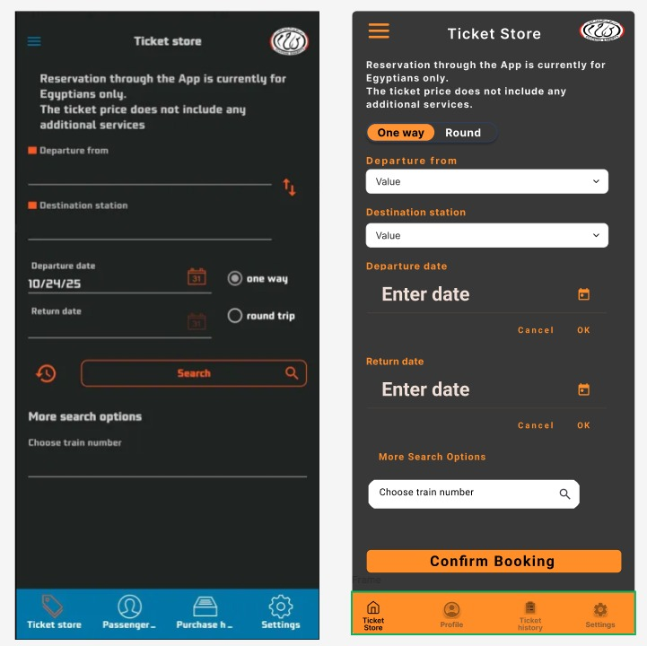
1. Better Visually
2. Improved Readability & Contrast
3. Clear Call to Action
4. Better User Guidance
5. Consistent & Modern Design

Slide 3
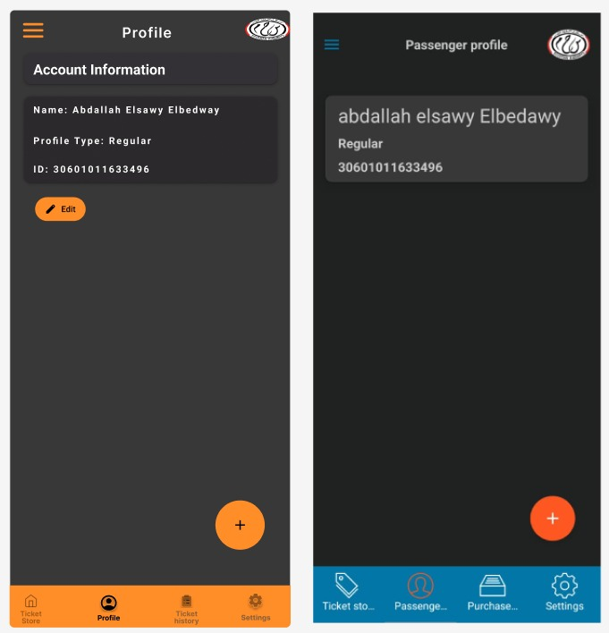
1. Clear Information Structure
2. Better Readability
3. Clear Actions & Interactivity
4. Modern & User-Friendly Look

Slide 4
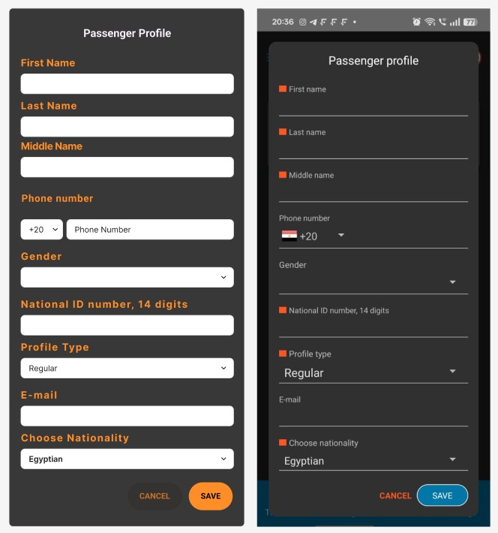
1. Clear Form Layout
2. Better Readability & Visibility
3. Improved Data Entry Experience
4. Reduced User Errors
5. Clear Actions

Slide 5
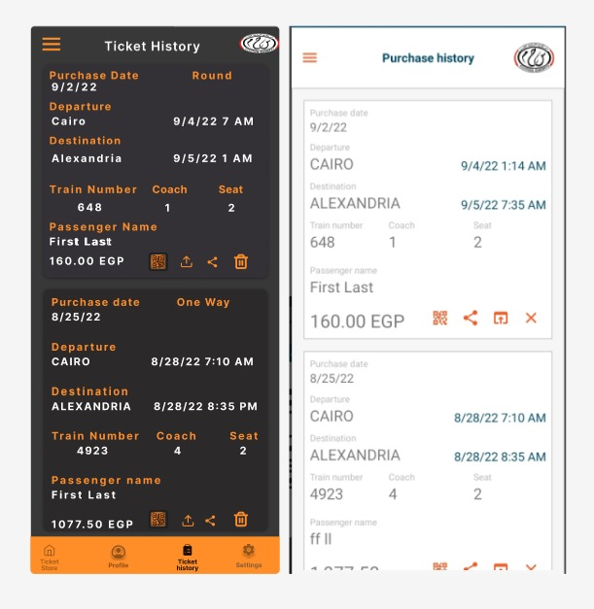
1. Better Information Layout
2. Improved Readability & Focus
3. Clear Separation Between Tickets
4. Clear Actions & Icons

Slide 6
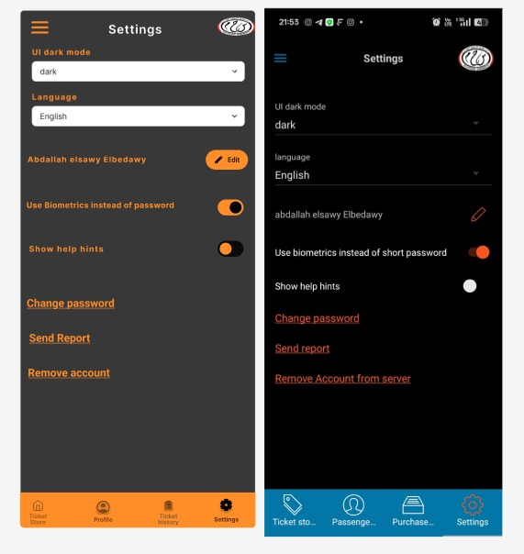
1. Better Visual Clarity
2. Improved Information Layout
3. Lower Cognitive Load
4. Modern and Consistent Design

